Slide 1
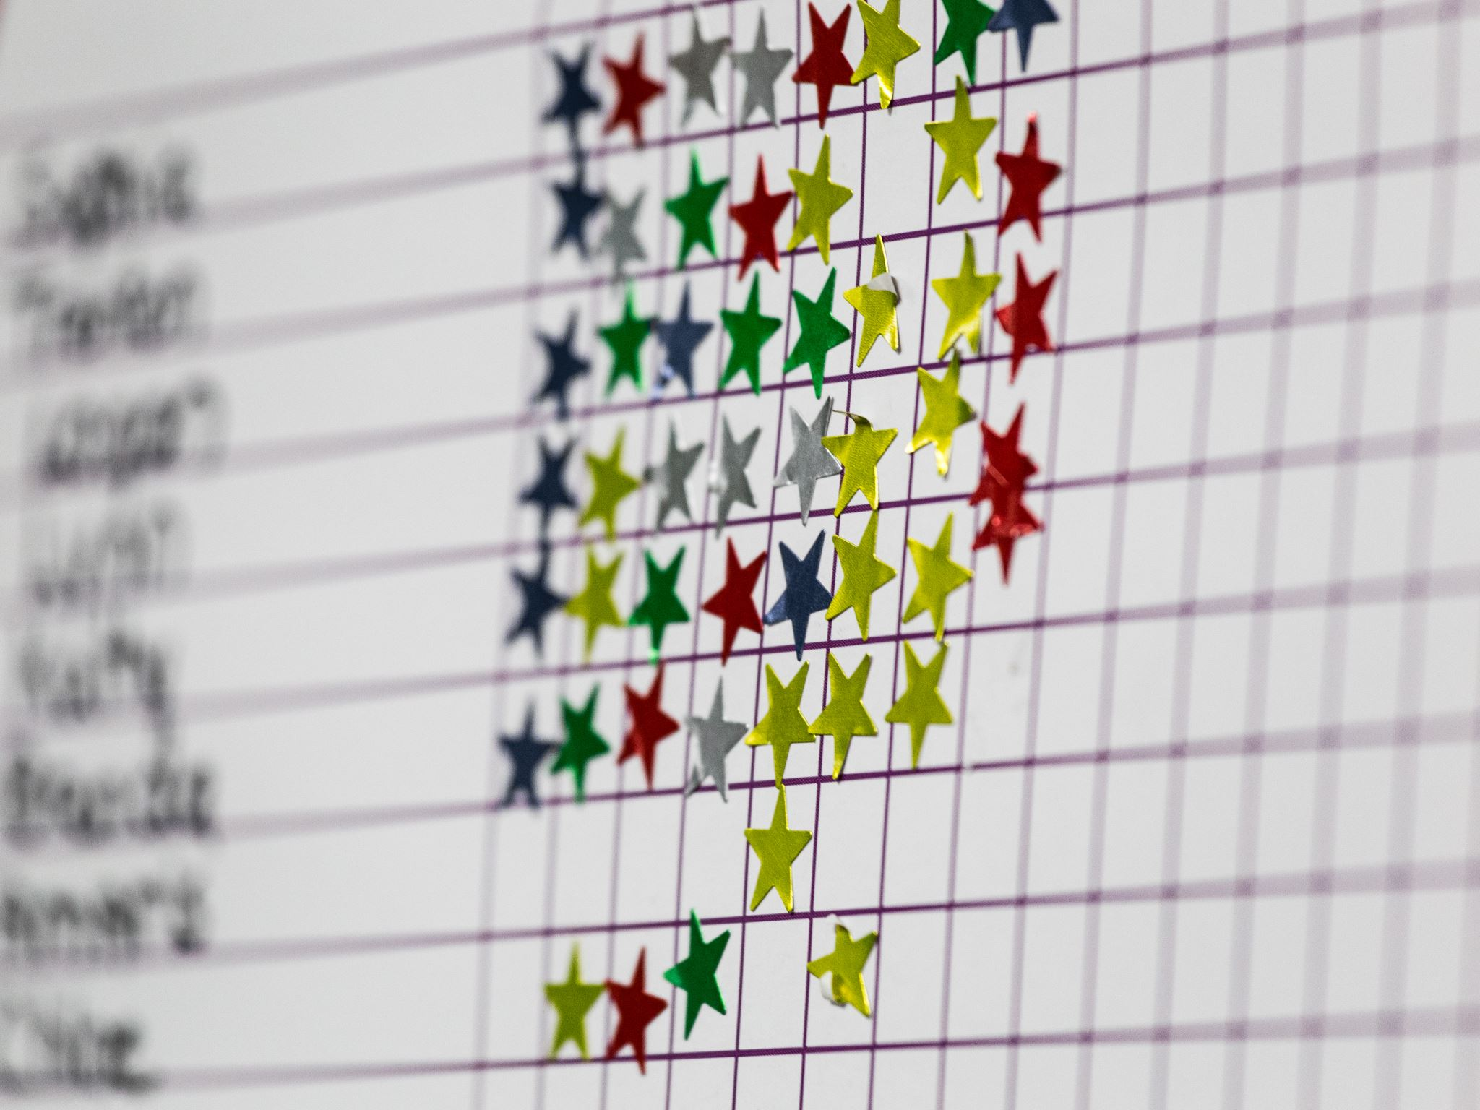

School Development – Review 1
What does it mean for us

Slide 2
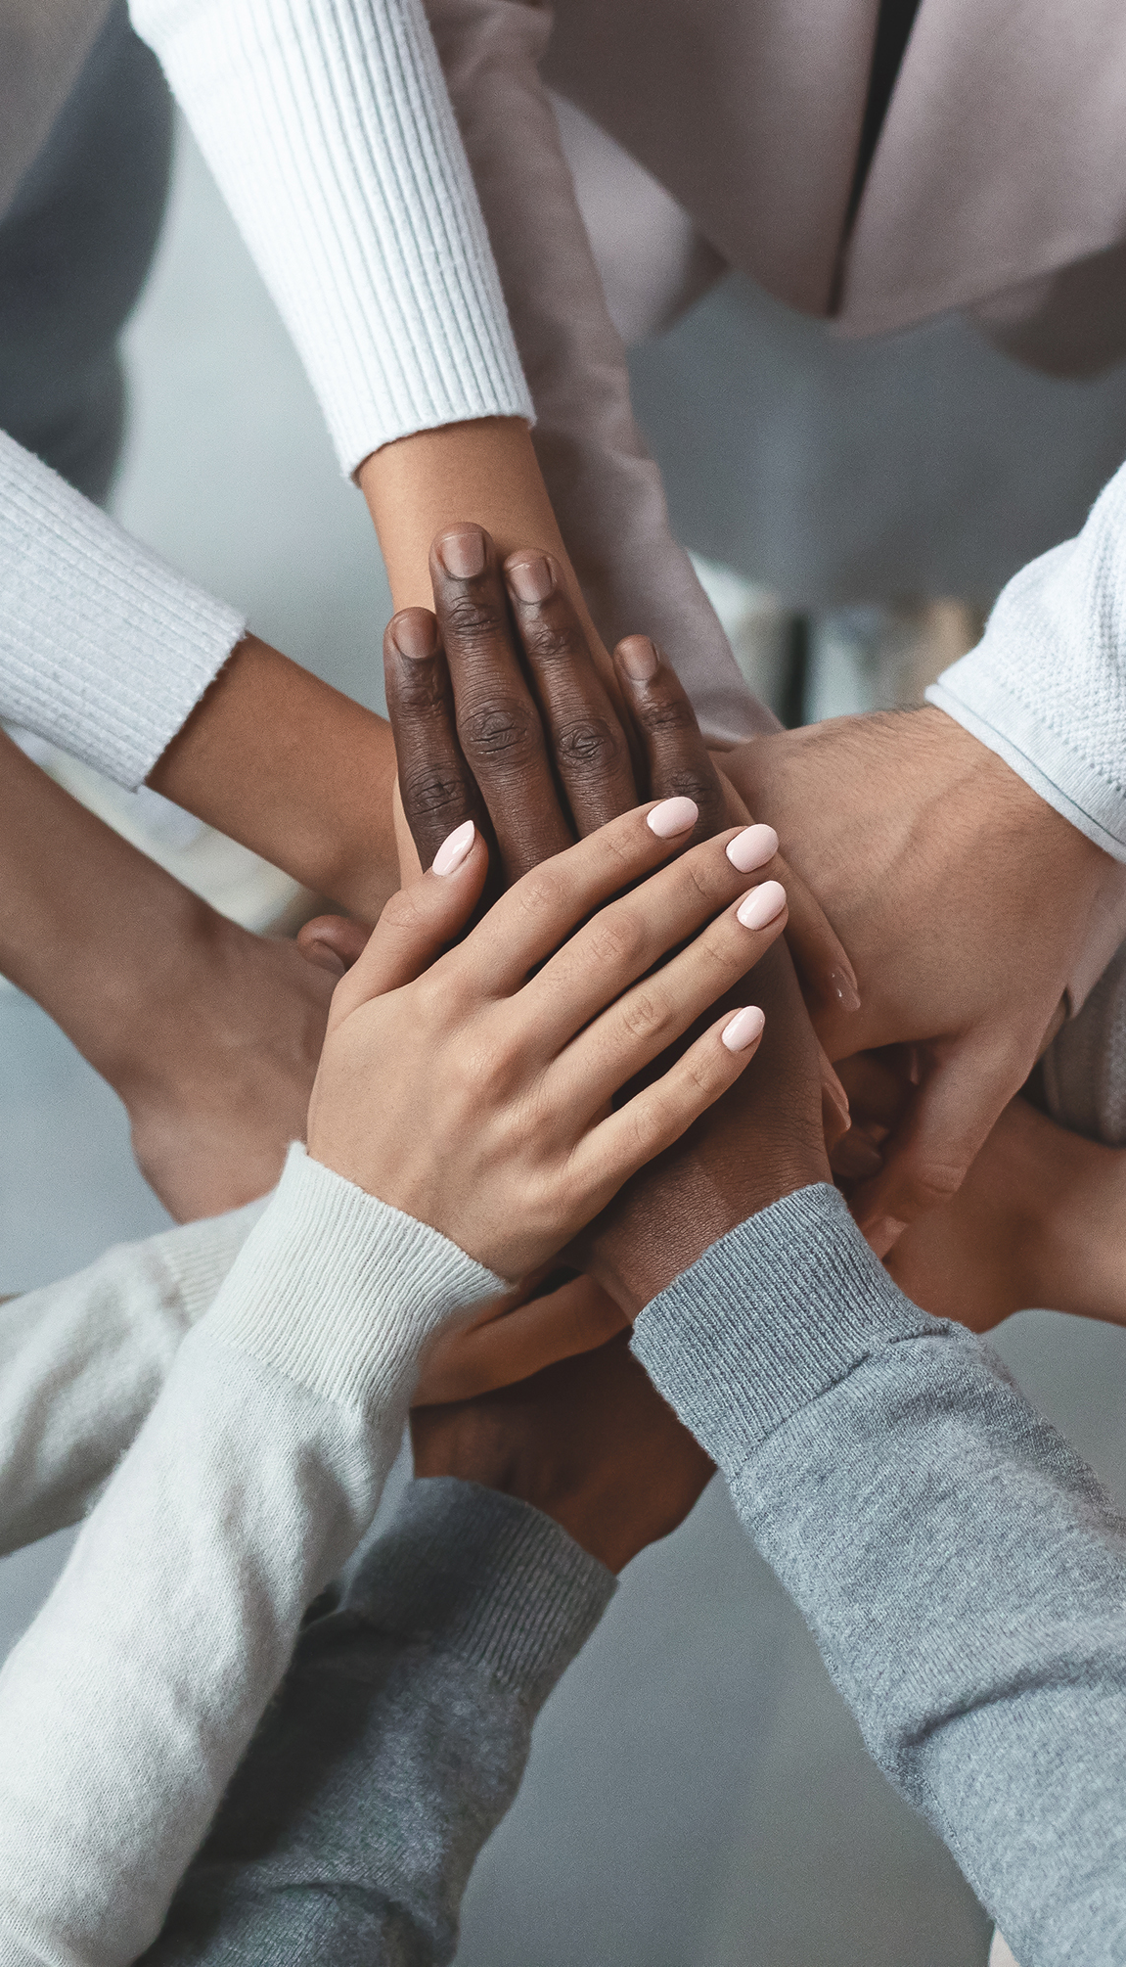
2025-2026
4 priorities + 1 extra special
School leadership
Good teaching and learning
Checking how we do
Support for anyone who needs little more help

Slide 3
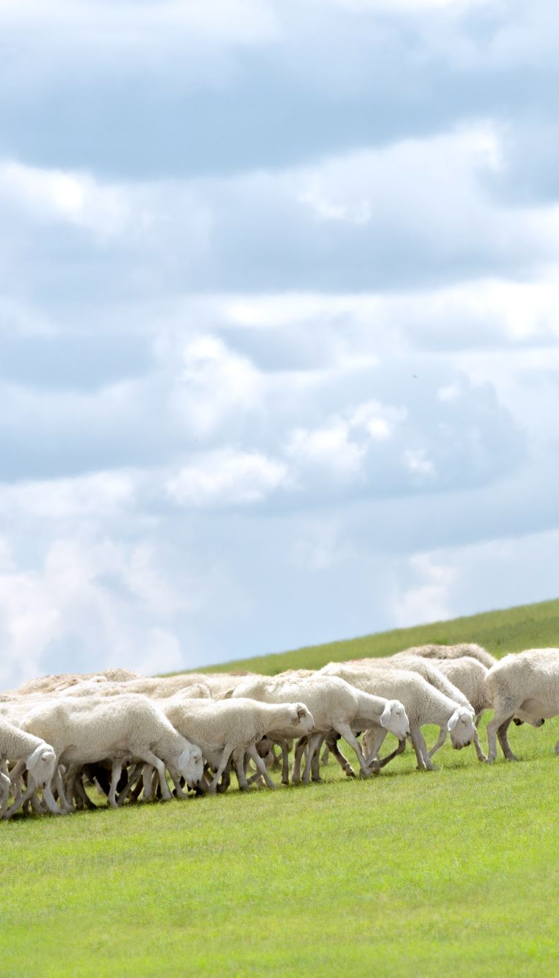
Leadership – What does it mean?
Vision statement
Y Sennedd, Criw Cymraeg, Eco Club
School leaders (grown ups)
More learning for grown ups

Slide 4

What have we done so far
Criw Cymraeg – Weekly assembly, monitoring Welsh speaking, Welsh games
Y Senedd – Healthy eating poster, Vision
Eco Club – Starting now
Pupils’ jobs – Working to keep the school tidy
Mrs. Shearman and Mrs. Morris – Assistant headteacher
Mrs. Caine – Supporting with children when they need more help

Slide 5
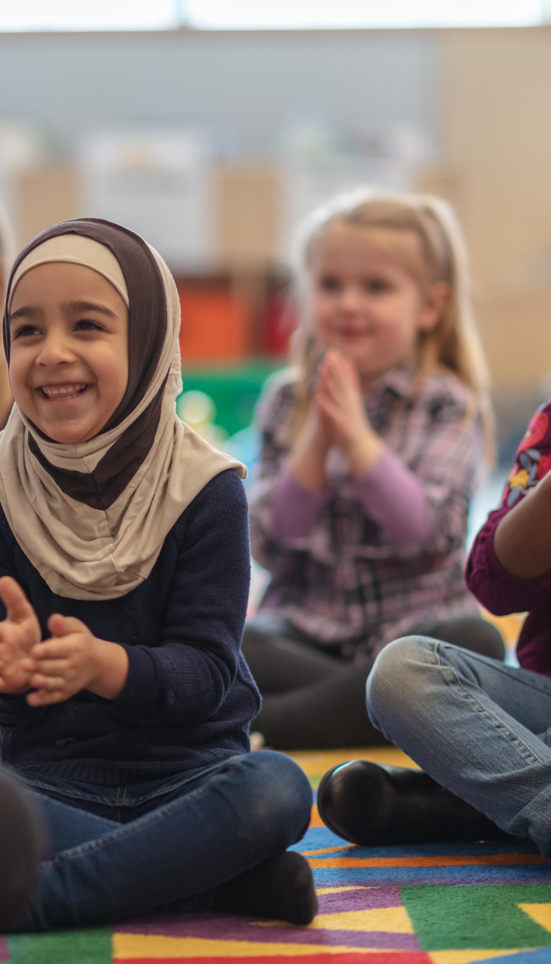
Good teaching and learning
Who is the teacher?
Who can help?
How can I work on my own learning?
What is independent?

Slide 6

Progress this term so far
MILES
3 before me
Speaking to visitors confidently
Independent learner
10 minutes write
Grown-up have done LOTS of learning and LOTS of homework

Slide 7
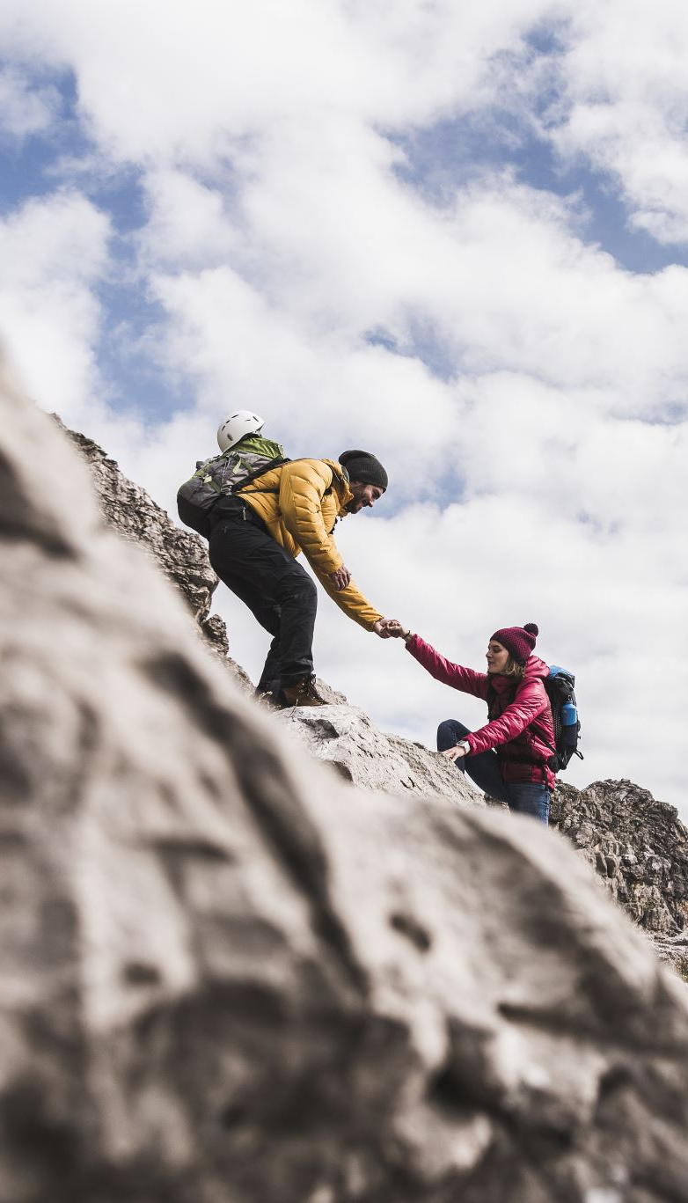
Support for anyone who needs little bit more help
Who is ALNCo?
What does it mean?
Who can I ask for help?
How do adults ask for help?

Slide 8

How well are we doing so far
Adult to help
Documents
Oeri – Support hub
Check-ins
3 before me

Slide 9

Plus one extra special
WELSH
Working towards
SILVER
Siarter Iaith

Slide 10


SO FAR WE HAVE DONE
Siaradwr Cymraeg Yr Wythnos
Graffiti wall
Board
Wesh reading – Tric a Chlic, Fflic a Flac
Cwestiwn yr Pythefnos
The Welsh Whisperer
SCHOOL SONG – LET’S PRACTICE

Slide 11
Cefnllys Song
There’s a school, in Llandrindod,
Where the children, are happy and kind
Always caring, always sharing,
Ysgol Cefnllys, y gorau yn y byd.

Slide 12
All our teachers, are so helpful,
Yn y dosbarth, they help us with our work
Always smiling, when we’re learning,
Diolch yn fawr i chi

Slide 13
Ysgol Cefnllys, croeso i chi,
Always working hard, to be the best we can be
Bendigedig, ac arbennig
We are safe, ready and respectful

Slide 14
Our mascots, help us to learn
Everywhere we look, everywhere we turn
Healthy Hugo, Enterprising Edward
Ambitious Aurora and Ethical Ethel

Slide 15
When we’re playing, with our friends
We’re so happy, the fun never ends
Amser aur, chwarae pêl droed,
We’re so grateful, for the memories that we make

Slide 16
Ysgol Cefnllys, croeso i chi,
Always working hard, to be the best we can be
Bendigedig, ac arbennig
We are safe, ready and respectful
(2x)

