Slide 1


School Development
What does it mean for us

Slide 2

2025-2026
4 priorities
School leadership
Good teaching and learning
Checking how we do
Support for anyone who needs little more help

Slide 3
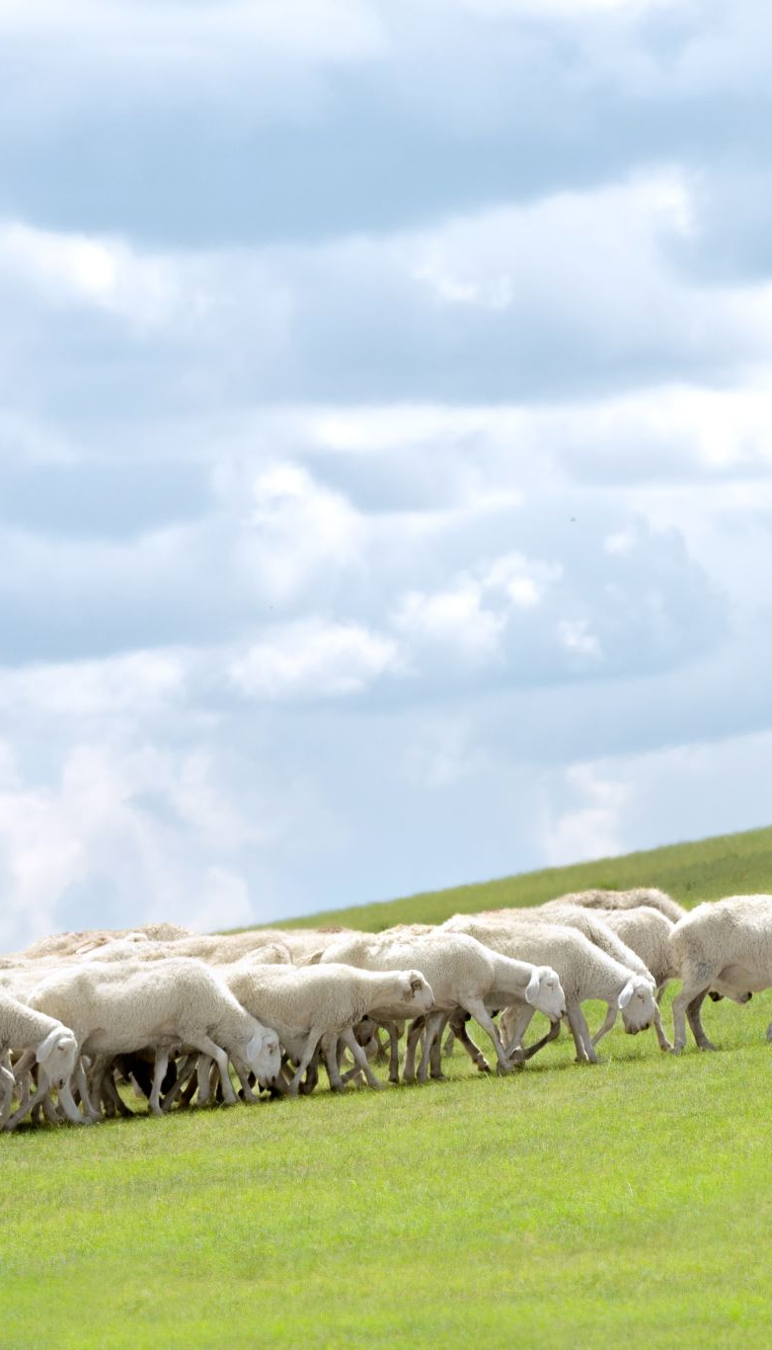
Leadership – What does it mean?
Vision statement
Y Sennedd, Criw Cymraeg, Eco Club
School leaders (grown ups)
More learning for grown ups

Slide 4
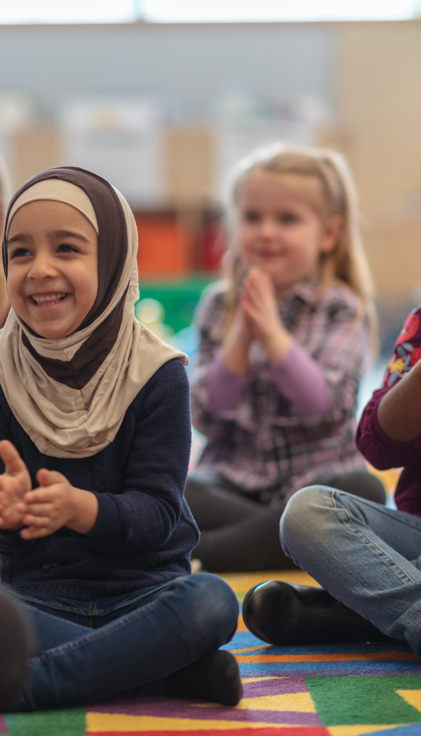
Good teaching and learning
Who is the teacher?
Who can help?
How can I work on my own learning?
What is independent?

Slide 5

How do we know we are successful
How do we mark?
How do we check?
How do we know what’s next?

Slide 6
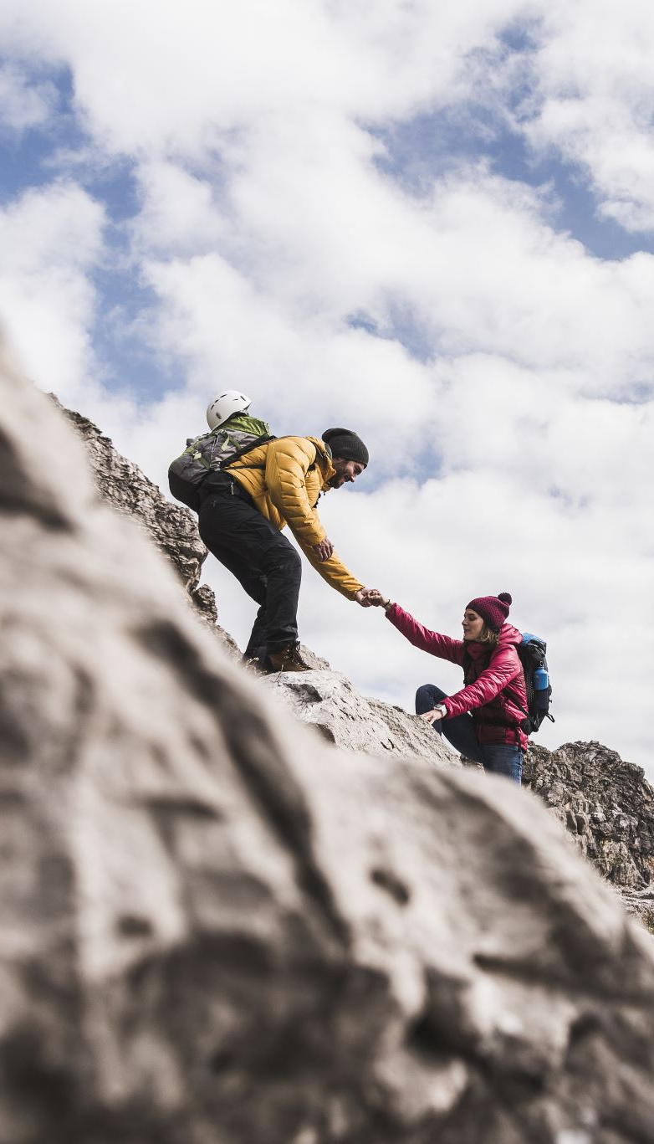
Support for anyone who needs little bit more help
Who is ALNCo?
What does it mean?
Who can I ask for help?
How do adults ask for help?

Slide 7

Plus one extra special
Working towards
SILVER
Siarter Iaith

