Slide 1






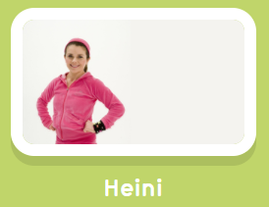



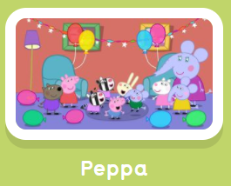

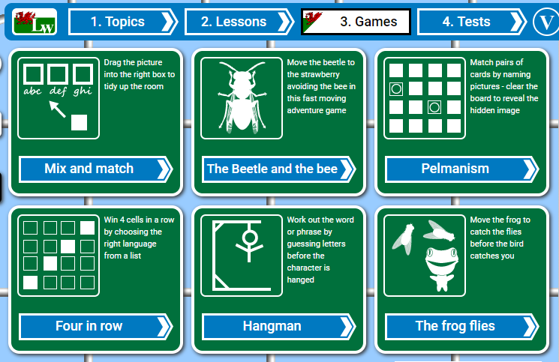





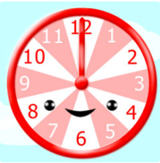


Gwefannau - Websites
http://cymraeg.gov.wales
www.geiriadur.bangor.ac.uk
Cyw
watch children’s TV
www.s4c.cymru/ciwtiwb
S4C – Welsh TV
www.s4c.cymru
www.geiriaduracademi.org
www.learnwelsh.net
Urdd Gobaith Cymru
www.urdd.cymru
Listen to stories and rhymes
www.poridrwystori.org.uk/audio-stories
www.poridrwystori.org.uk/audio-rhymes
www.bbc.co.uk/wales/learning/learnwelsh
www.canolfanpeniarth.org
web and interactive
Clock Game

Slide 2
Gwefannau - Websites
http://cymraeg.gov.wales
Cyw
watch children’s TV
www.s4c.cymru/ciwtiwb
Listen to stories
and rhymes
www.poridrwystori.org.uk/audio-stories
www.poridrwystori.org.uk/audio-rhymes
www.bbc.co.uk/wales/learning/learnwelsh

Slide 3
Gwefannau - Websites
www.canolfanpeniarth.org
Click on:
web and interactive
Clock Game
www.learnwelsh.net
Urdd Gobaith Cymru
www.urdd.cymru
www.bbc.co.uk/wales/learning/learnwelsh
http://cymraeg.gov.wales

Slide 4
Gwefannau - Websites
http://cymraeg.gov.wales
www.geiriadur.bangor.ac.uk
S4C – Welsh TV
www.s4c.cymru
www.learnwelsh.net
www.geiriaduracademi.org
Urdd Gobaith Cymru
www.urdd.cymru
www.canolfanpeniarth.org
Click on :
web and interactive
Clock Game
www.bbc.co.uk/wales/learning/learnwelsh

