Slide 1

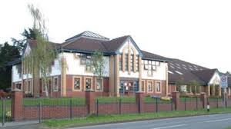
Our Health and Wellbeing Journey at
Ysgol Cefnllys
K.Jenkins – Head teacher
head@cefnllys.powys.sch.uk

Slide 2
Our starting point – September 2017
No consistent consequences or rewards for children
Regular exclusions – 2017-18 school was in top 10 Powys Primary schools with most exclusions
Behaviour Incidents. Regular disruption to nearly all classes
Incidents of violent behaviour and verbal abuse to staff and pupils
43% parents thought pupil’s behaviour was an issue, 40% pupils said behaviour affected them in the classroom and 32% saw behaviour at playtimes as an issue

Slide 3
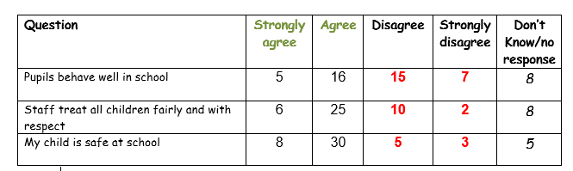
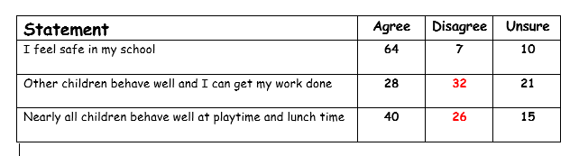
Questionnaire results 2017
Parent questionnaire results in 2017
Pupil questionnaire results in 2017

Slide 4


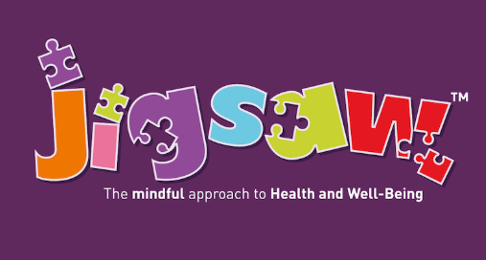
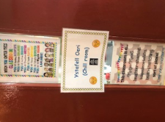

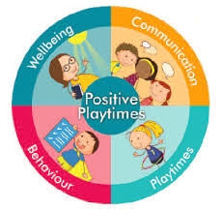

In September 2017 we ensured the basics of behaviour management were implemented with a whole school policy based on rewards and sanctions
The impact was a more settled and consistent approach to behaviour understood by pupils, staff and parents
However we soon realised this wasn’t sufficient for the children in our school and the holistic approach to Health & Wellbeing at our school has continued to develop
ACES TRAINING
" I CAN SEE SCRIPTS "

Slide 5
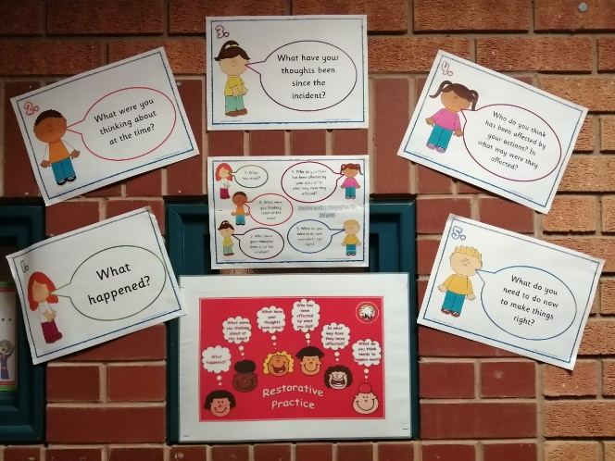
Restorative Justice
Undertook training with key staff – SLT and teachers and support staff
All staff carry the 5 questions in their lanyards
Annual refresher training for all staff
See this link for further info http://www.restorativejustice4schools.co.uk/wp/?page_id=26

Slide 6
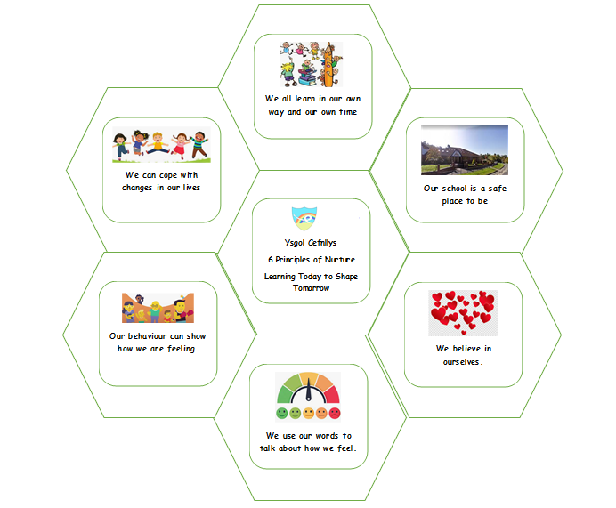
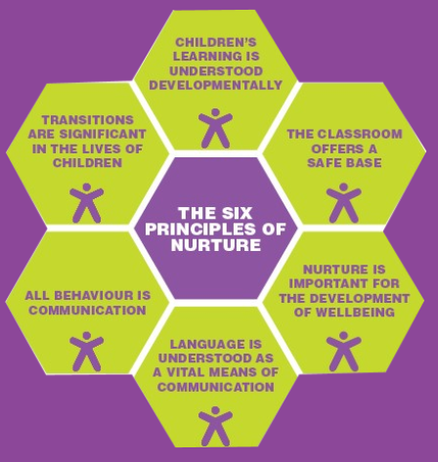
The nurturing approach offers a range of opportunities for children and young people to engage with missing early nurturing experiences, giving them the social and emotional skills to do well at school and with peers, develop their resilience and their capacity to deal more confidently with the trials and tribulations of life, for life.
The Boxall Profile is a two-part assessment tool designed to track the progress of cognitive development and behavioural traits of children and young people through their education. The two-part checklist, which is completed by staff who know the child and young person best, is quick — and, very importantly, identifies the levels of skills the children and young people possess to access learning.

Slide 7
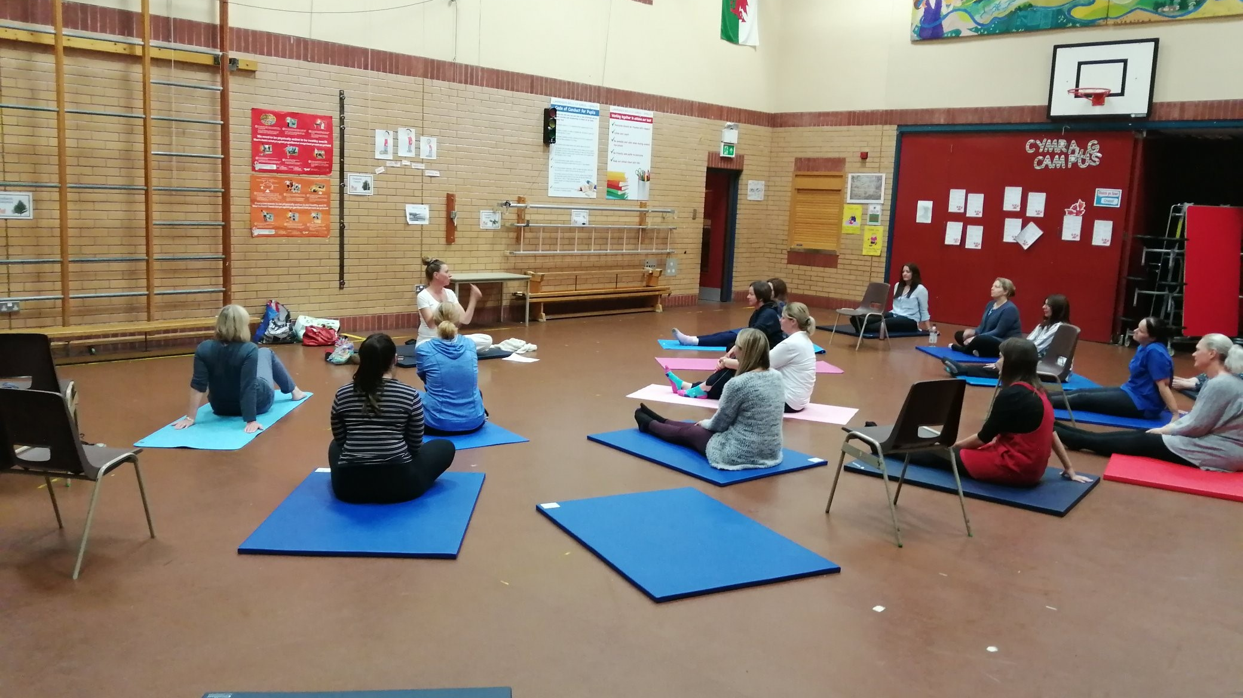
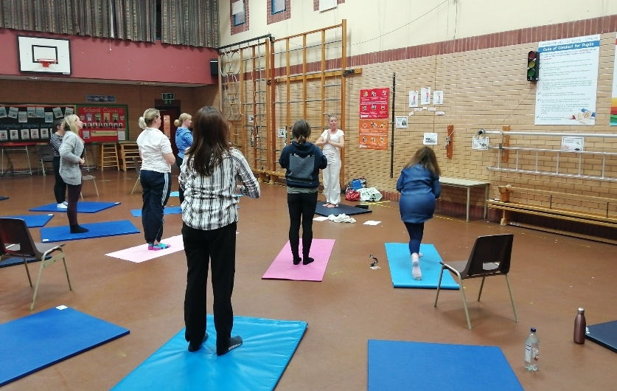
YOGA
In the Spring and Summer terms 2019 we have been lucky to have Georgie the yoga teacher in to school funded jointly with a local school, she has carried out yoga sessions with all children from Year 2-6. Our staff received training for 5min yoga for children so that they can carry on these invaluable sessions.

Slide 8
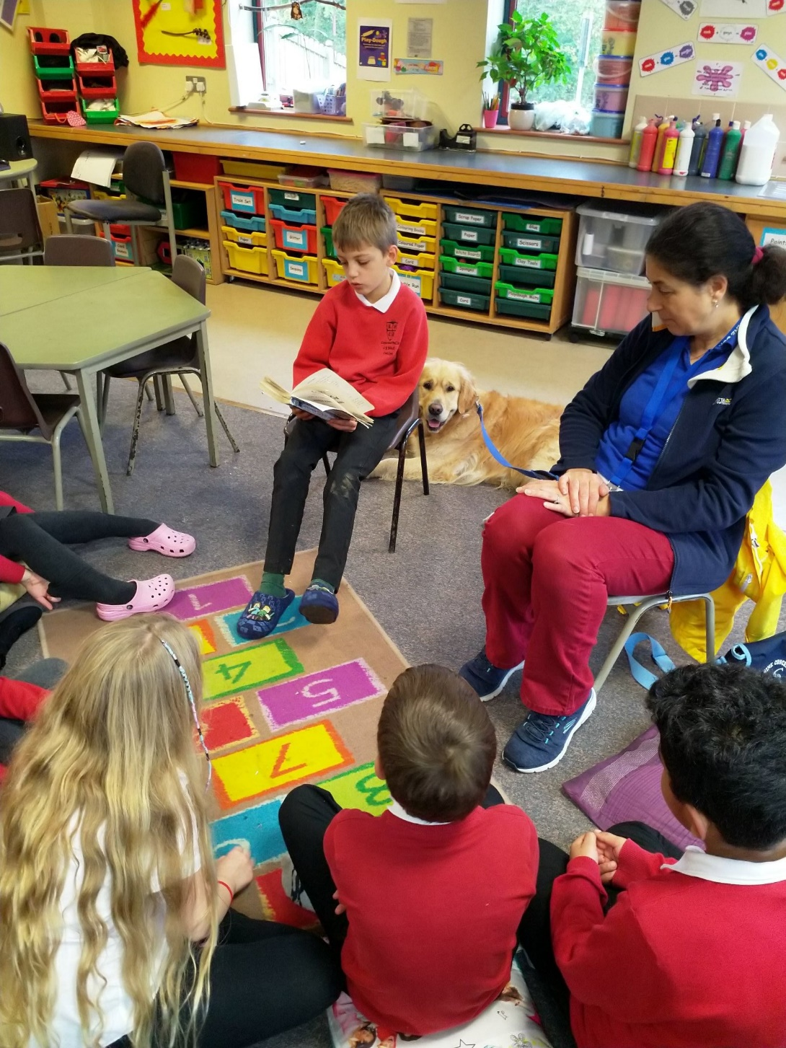
MONTY THE CANINE THERAPY DOG

Slide 9
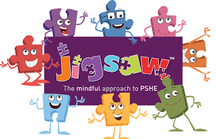
Within our classes we use the Jigsaw scheme to develop our PSHE approach. Each week classes have a circle time and follow a whole school scheme. Jigsaw is a unique, spiral, progressive and effective scheme of work, aiming to prepare children for life, helping them really know and value who they truly are and understand how they relate to other people in this ever-changing world.

Slide 10
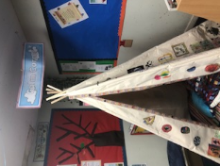
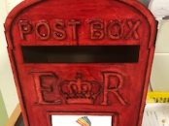
YSTAFELL OERI
This is a chill room which pupils access at breaktimes and lunch times in different ways.
Pupils can be sent to Ystaffell Oeri if there has been a behaviour problem in class or at play.
Children can go the Ystaffell Oeri through own choice eg: if they are upset or feeling themselves getting cross.
The member of staff in Ystaffell Oeri will them work with the child/children in whichever way the situation requires.
Some approaches used are:
Simply giving the child time to talk and having someone to listen.
Restorative approach if a behaviour issue with group.
Giving the child a space.
Engaging a child in an activity and some CBT.
Engaging a child through a Thrive based approach – Attune, validate, contain, soothe, calm, stimulate (catch it and match it)
Yoga or breathing activity.
Mindful colouring.

Slide 11

“We enjoyed the Kidscape session with Carole and learnt a lot from it. We enjoyed taking part in role play activities and particularly enjoyed the ‘Broken Record’ which was when you continued to say the same thing over and over again to someone who was being unkind to you so that they got fed up and stopped bothering. Another good idea was ‘Fogging’ – this was when you pretend that you are in your own cloud and this calms you down and builds your confidence. Overall, we enjoyed this session and feel it was beneficial.”
PUPIL FEEDBACK

Slide 12

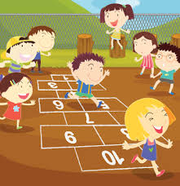

Positive playtimes with jenny Moseley
We have the following zones
FOOTBALL QUIET CRAZE OF THE WEEK
TRADITIONAL GAMES ROLE PLAY
BALL GAMES

Slide 13
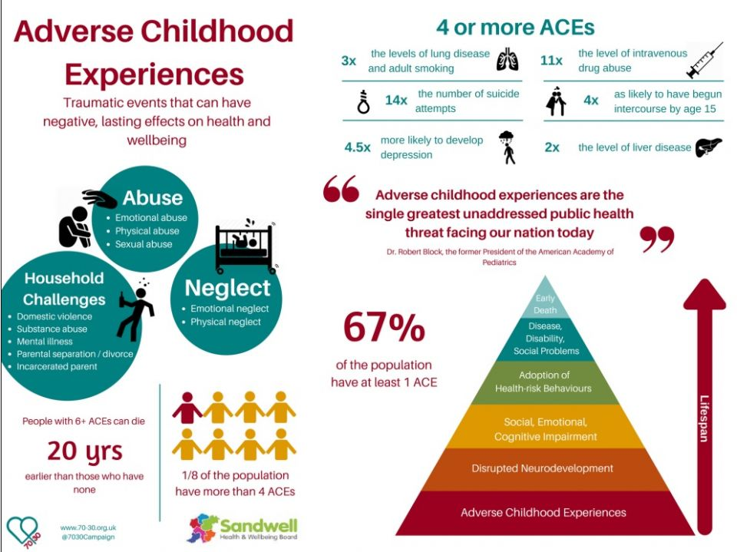
All staff received ACEs training in order to understand the needs of the children in our school

Slide 14
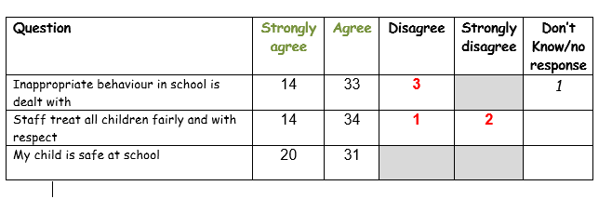
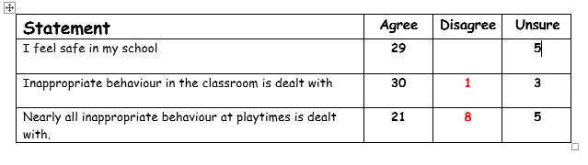
Questionnaire results 2019
Parent questionnaire results in 2019
6% parents view pupil’s behaviour was an issue
Pupil questionnaire results in 2019
1% pupils say behaviour affected them in the classroom and 9% see behaviour at playtimes as an issue

Slide 15
What’s next?
Develop children as listeners. Recruit and train peer mentors/buddies in Ystafell Oeri. Playing games with children to calm before the staff chat.
Measure and track the wellbeing of children in our school, so that support is tailored to individual needs
Review our holistic package and develop/change when required

Slide 16
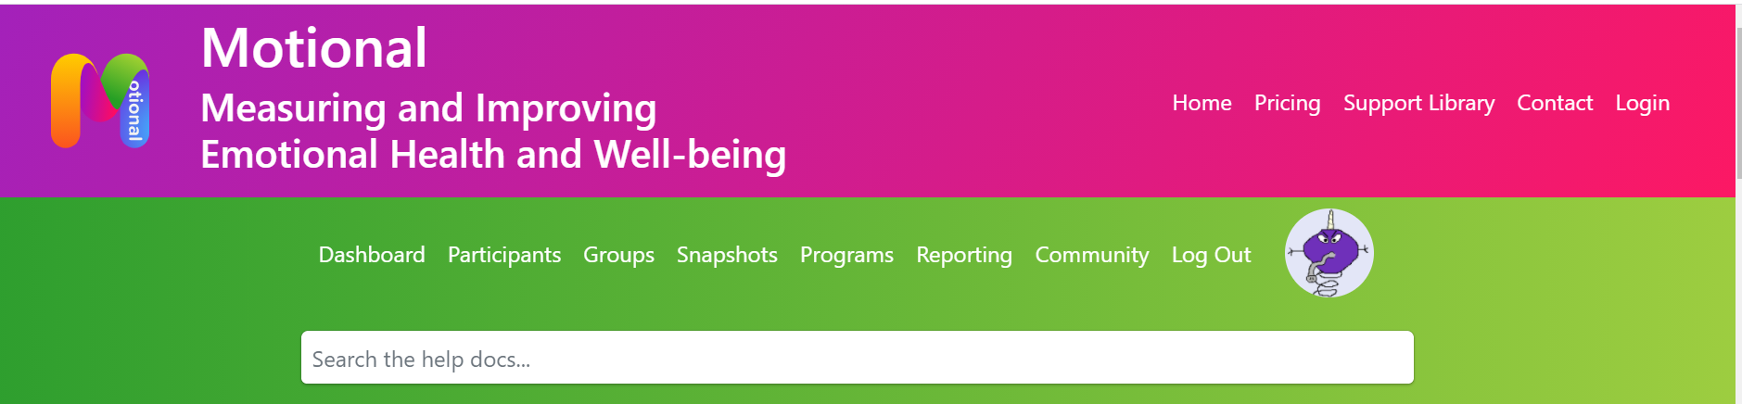
Trauma Informed School
In the Spring of 2021, 2 members of staff achieved the qualified status of Trauma informed schools Diploma with the objective of moving towards Whole school Trauma Informed School Status.
What is a Trauma informed school?
A trauma informed school is one that is able to support children and teenagers who suffer with trauma or mental health problems and whose troubled behaviour acts as a barrier to learning.
We are moving on our journey to this via subtle but consistent changes in approach including regular check-ins, behaviour blueprints, emotional well being stepping stones etc.
To help us assess our pupils and provide best practice with our programmes of support we also introduced Motional.
What is Motional and how does it work?
Motional measures different emotional systems in the brain (CARE, SEEKING, PLAY, FEAR, RAGE, PANIC/GRIEF based on prof Jaak Panksepp’s work) and several key executive function skills (handling stress, thinking & concentration, confidence & self-esteem, interpersonal skills, and emotional literacy) to give a whole brain picture of a child’s emotional and mental health.
Staff complete on-line snapshots of pupils which are then assessed and evaluated.

